Slide 1


Design & Develop Front End Community Portal
Module Project
Module: NICF-UI Frameworks
Course: NICF-Advanced Certificate in Web Development
Start Date : 28 November 2022
End Date : Submission Date :
Learner Name Enrollment ID
:
:
Agung Yuda Pratama
21 Desember 2022
BDSE-0922-076
21 Desember 2022
Presentation Date : 12 February 2023

Slide 2
Document History
Version Number | Effective Date of release | Summary of Included Changes | Author
1 | 4th March 2016 | First Edition | Satya CVS
2 | 7th April 2017 | Changed for Module 2 | Shrinivas K R
3 | 14th May 2017 | Changed for Module 3 | Shrinivas K R
4 | 03rd May 2018 | Changed for RQF | Shrinivas K R
5 | 16th Sep 2018 | Change for Java Track | Shrinivas K R

Slide 3
Contents
S. No. | Description
01 | Development Tools
02 | Feedback Techniques
03 | Pages Inventory
04 | Forms & Pages Design
05 | Forms & Pages Feedback
06 | HTML Pages
07 | Usability Metrics
08 | User Interaction Steps
09 | User Interaction Flowchart
10 | Current & Desired Usability
11 | Prototype Screen
12 | Prototype Feedback
13 | Usability Test
14 | Project Milestones & Tasks
15 | Milestone Feedback & Action taken
16 | Project Results
17 | Proposed Improvements

Slide 4

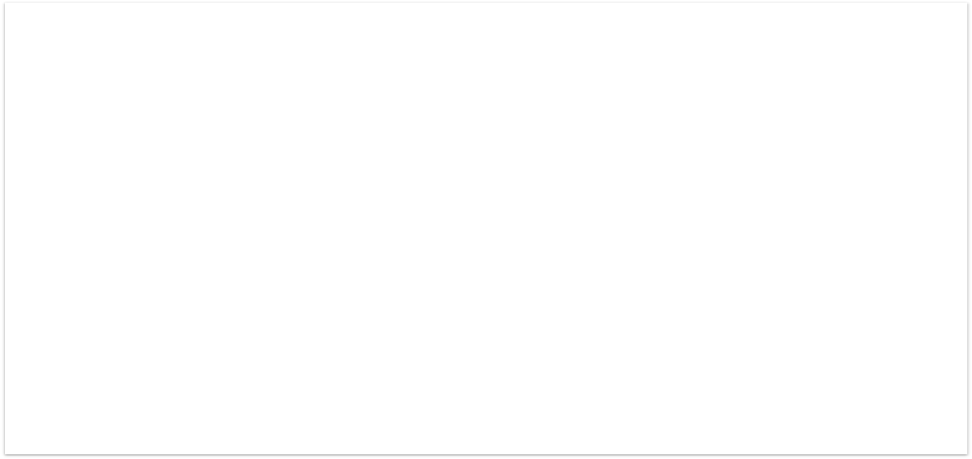
1. Development Tools
Development Tools Screen captures
Laptop Acer Aspire 5
Windows 10
Google Chrome
Microsoft Edge
Lightshot
GoFullPage Chrome

Slide 5

2. Feedback Techniques
Feedback-gathering techniques
Interview
Utilizing Interviews to gather user feedback allows people to express their opinions about what they think is working and what is not. Observation
This approach is primarily employed during the development phase. The production teams will test the product or prototype on users and watch their behavior to see if it functions as intended and whether they are having any problems completing the task.
I am using Observation and Surveys because we are in the development process and usability testing.

Slide 6
3. Pages Inventory
List of Pages for which UI need to be developed
S. No. | Page Name
1 | Community Portal Home Page
2 | Registration Page
3 | Registration Confirmation Page
4 | Update Profile Page
5 | Search Users Page
6 | List Search Results
7 | Public Profile Page
8 | Registration Confirmation Email
9 | Login Page
10 | Forget Password Page
11 | Design the Forget Password Confirmation Page

Slide 7
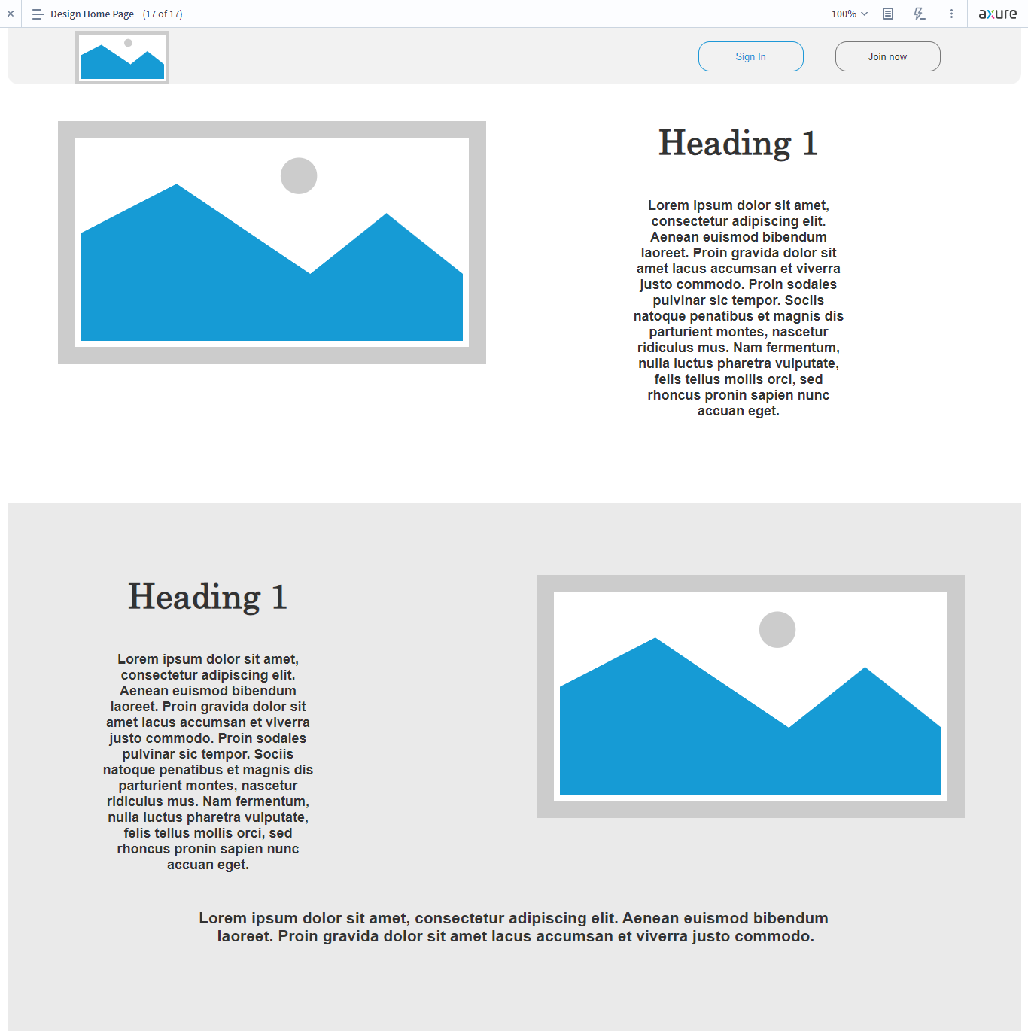
4. Forms & Pages Design

Slide 8
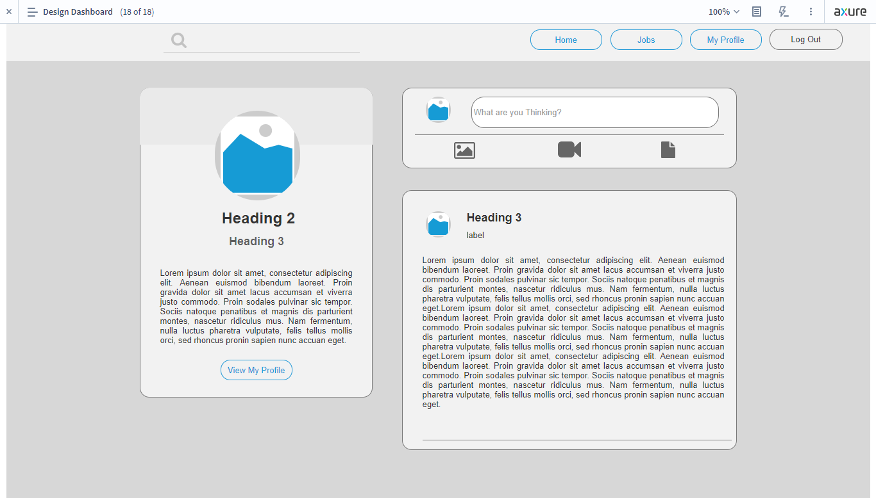
4. Forms & Pages Design

Slide 9
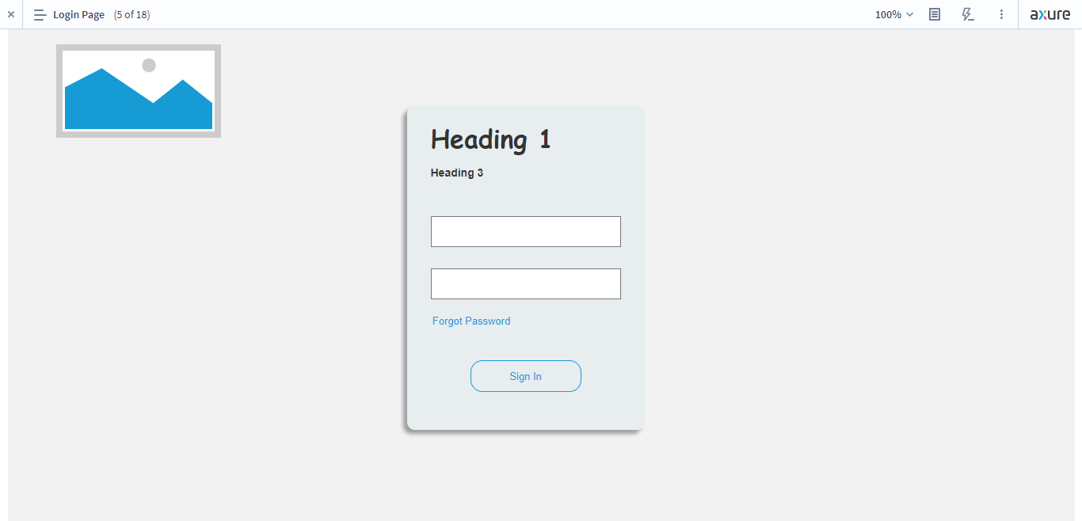
4. Forms & Pages Design

Slide 10
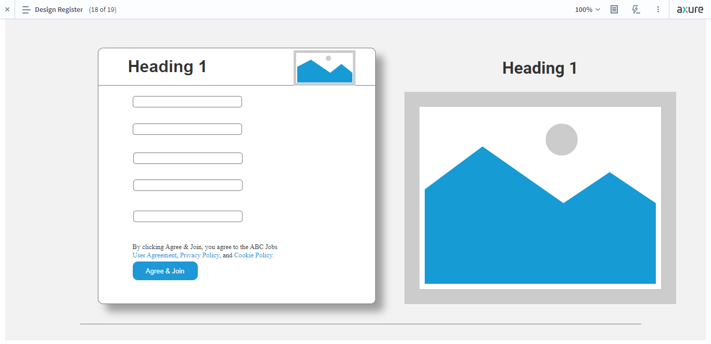
4. Forms & Pages Design

Slide 11
5. Forms & Pages Feedback
S. No. | Forms / Pages | Feedback Received | Modifications Implemented
1 | Community Portal Home Page | Must have a footer | Adding Footer
2 | Registration Page | Everything Is Good | Everything Is Good
3 | Registration Confirmation Page | Everything Is Good | Everything Is Good
4 | Update Profile Page | Not have button to close or cancel editing profile | Add button to close or cancel editing profile
5 | Search Users Page | Everything Is Good | Everything Is Good
6 | List Search Results | Everything Is Good | Everything Is Good
7 | Public Profile Page | Must have Small Biodata, React, Comment, and Share button | Adding Small Biodata, React, Comment, and Share button
8 | Registration Confirmation Email | Everything Is Good | Everything Is Good
9 | Login Page | Must have More Layout And Copyright | Adding More Layout And Copyright
10 | Forget Password Page | Everything Is Good | Everything Is Good
11 | Design the Forget Password Confirmation Page | Everything Is Good | Everything Is Good

Slide 12
5. Forms & Pages Feedback
S. No. | Forms / Pages | Feedback Received | Modifications Implemented
12 | Dashboard Page | Not have follow suggestions, react, comment, and share button | Adding follow Suggestion, react, comment, and share button
13 | Thank You Page | Everything Is Good | Everything Is Good
14 | My Profile Page | Not have follow suggestions, react, comment, and share button | Adding follow Suggestion, react, comment, and share button
15 | Company Search Result Page | Not have company search result | Adding company search result

Slide 13
7. Usability Metrics
There will be three metrics to measure the scenario task.
Time on Task (TOT)
It calculates the time it took the user to do the task. The usability is better when the faster time it takes. The average time of all participants will be used to compute the final score.
Task Success Rate (TSR)
Test the user's ability to finish the task. Overall participants, successful participants' final scores are displayed.
Customer satisfaction (CSAT)
KPI uses a valuable metric to express customer satisfaction. Very Unsatisfied, Dissatisfied, Neutral, Satisfied, and Very Satisfied were the categories on the scale. The final score is displayed in 6 using the formula below.
(number of satisfied)/number of respondents x 100%)

Slide 14
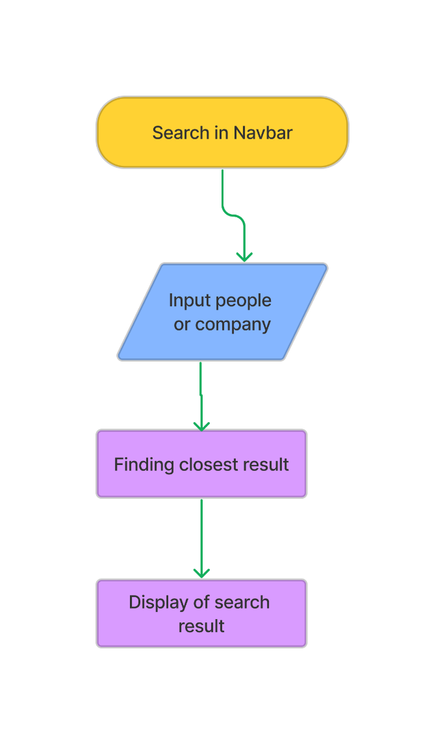
8-9. User Interaction Steps & Flowchart
Search Flowchart | Steps
 | 1. In navbar, we click the search field 2. Enter the name of the person or company 3. System will find the closest result 4. The If user press enter, it will display all of the result

Slide 15
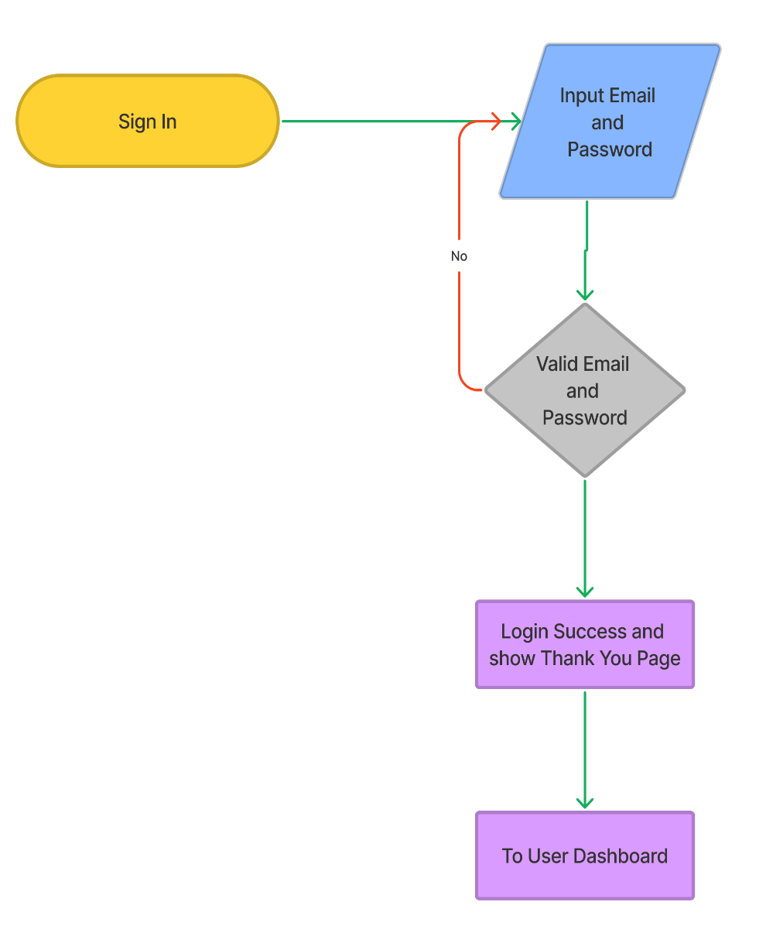
8-9. User Interaction Steps & Flowchart
Sign in Flowchart | Steps
 | 1. User goes to the Sign in Page. 2. user must enter the email and the password that has been made. 3. The system will check the data after the user clicks a sign-in button if valid user continues. If false or different user will re-enter the email and password again. 4.Next, Thank you page will show ,and there is a button to continue to User Dashboard.

Slide 16
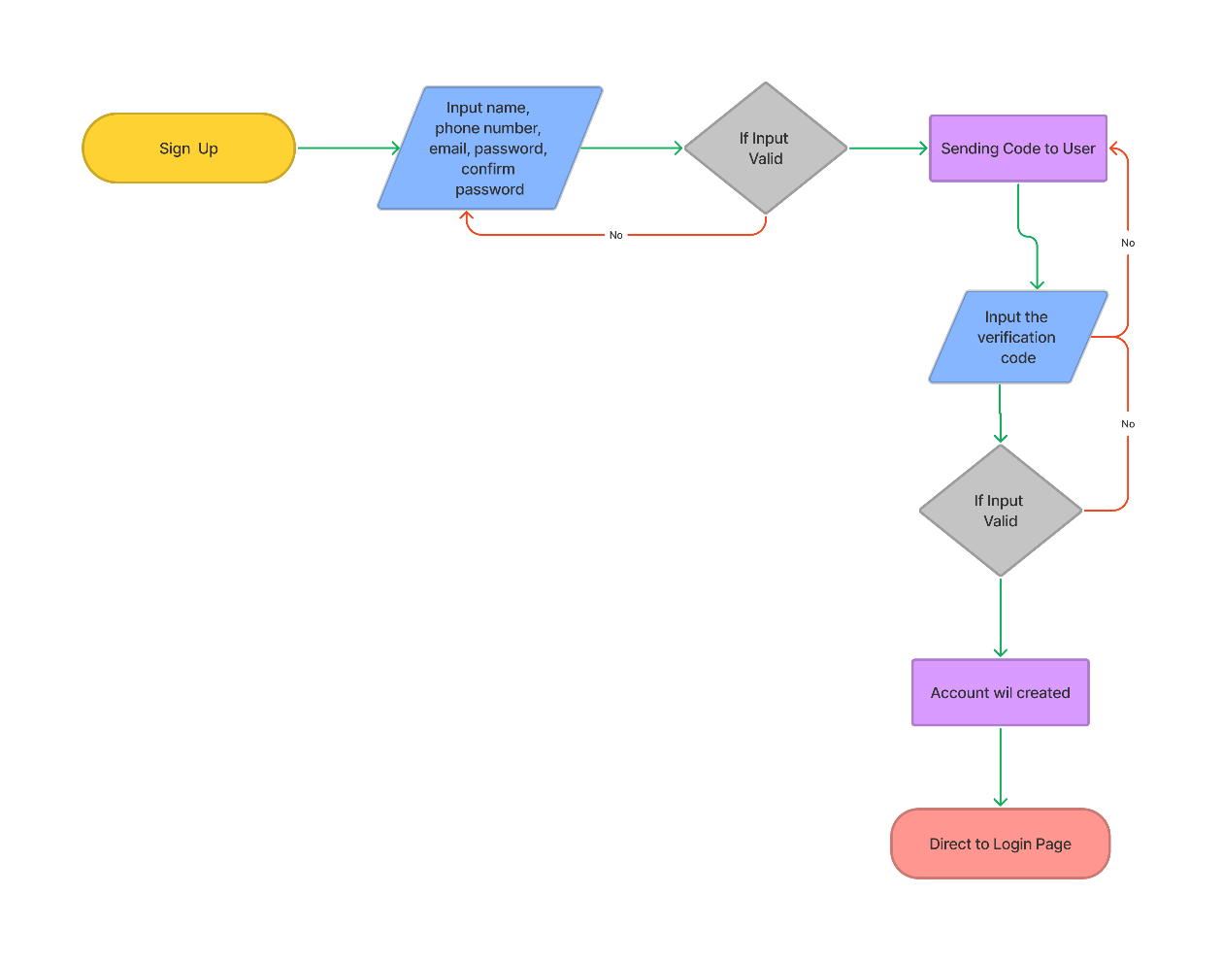
8-9. User Interaction Steps & Flowchart
Sign Up Flowchart | Steps
 | 1. User at the sign-up page. 2. User enters their name, phone number, email, and password, confirms the password, and clicks sign up. 3. If entries are invalid, the user will see an error state above the button. 4. If valid, a verification code will be sent on the next page. 5. If the user did not get the code, the user might click the resend button. 6. User inputs the verification code. 7. When clicking Create Your Account, the user will direct to create a profile 8. The page will direct to the login page.

Slide 17
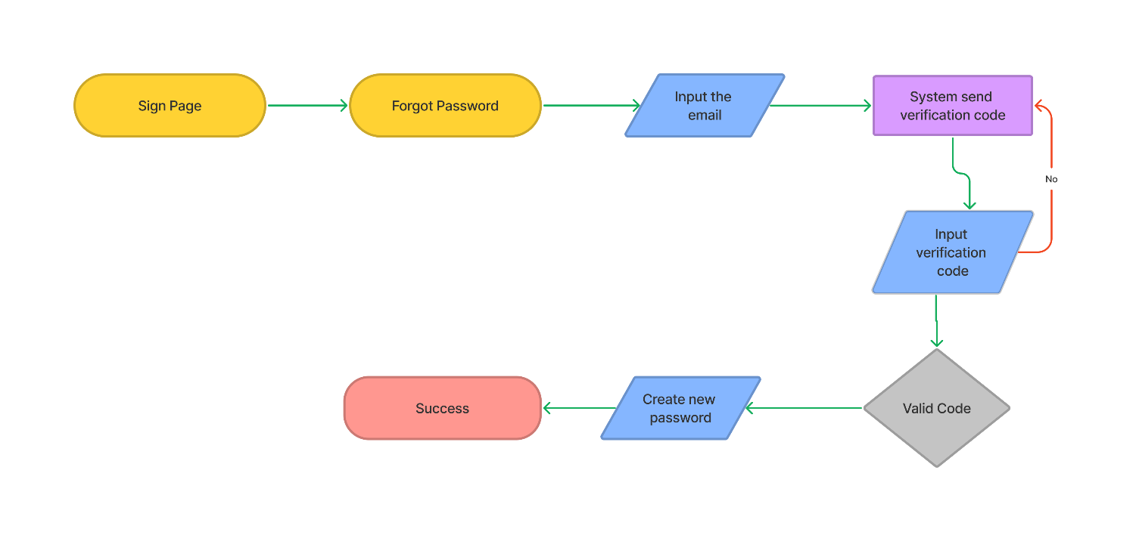
8-9. User Interaction Steps & Flowchart
Forgot Password Flowchart
1. User at the sign-in page and click the forgot password 2. User enters the email that is used for sign in 3. A code will be sent to the user's email 4. If the user did not get the email, the user might click the resend button 5. User opens their email and, copies the code verification, pastes in the email verification page. 6. User enters a new password and confirms the password 7. When success directed to sign in page

Slide 18
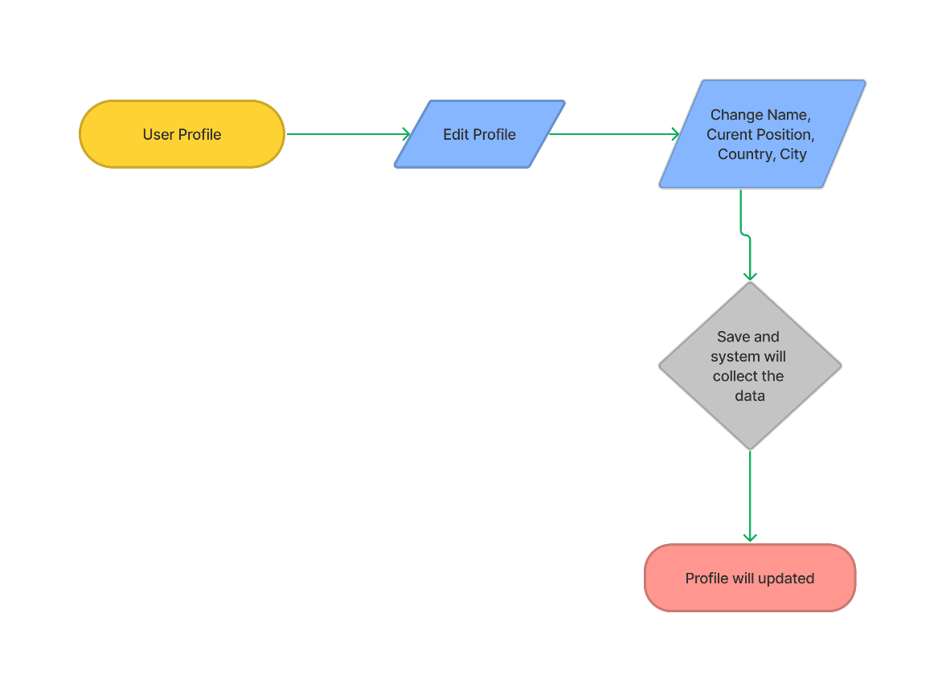
8-9. User Interaction Steps & Flowchart
Update Profie Flowchart | Steps
 | 1. Go to the user profile 2. Click edit profile 3. We can change the first name, last name, current position, country, and city. 4. After we complete editing the profile, we can click save 5. The system will collect and update the data

Slide 19
10. Current & Desired Usability
First Usability Test Using Task Success Rate
Registration new account.
Result
Overall, they can do with no issues except Anjar. When he tries to do registration, he always asks me step by step, but he can make it faster than Rahman.
They can navigate the community portal easier.

Slide 20
10. Current & Desired Usability
Second Usability Test Using Costumer Satisfaction
Login with new account.
Result
Overall, they can do with no issues. All participants are familiar with the login form.
Time on task faster than register because just a simple form.

Slide 21
10. Current & Desired Usability
Third Usability Test Task on Time
Forgot password account.
Result
On average, there are no problems. They can pass this Three Usability Test
Abdul Rahman always be on the long time in Three Usability Test.
Syukur the fastest person in this test.

Slide 22
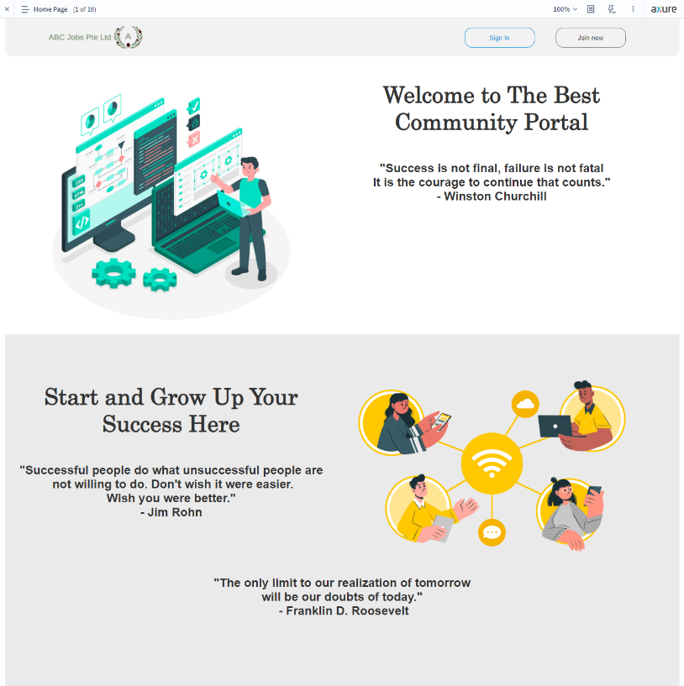
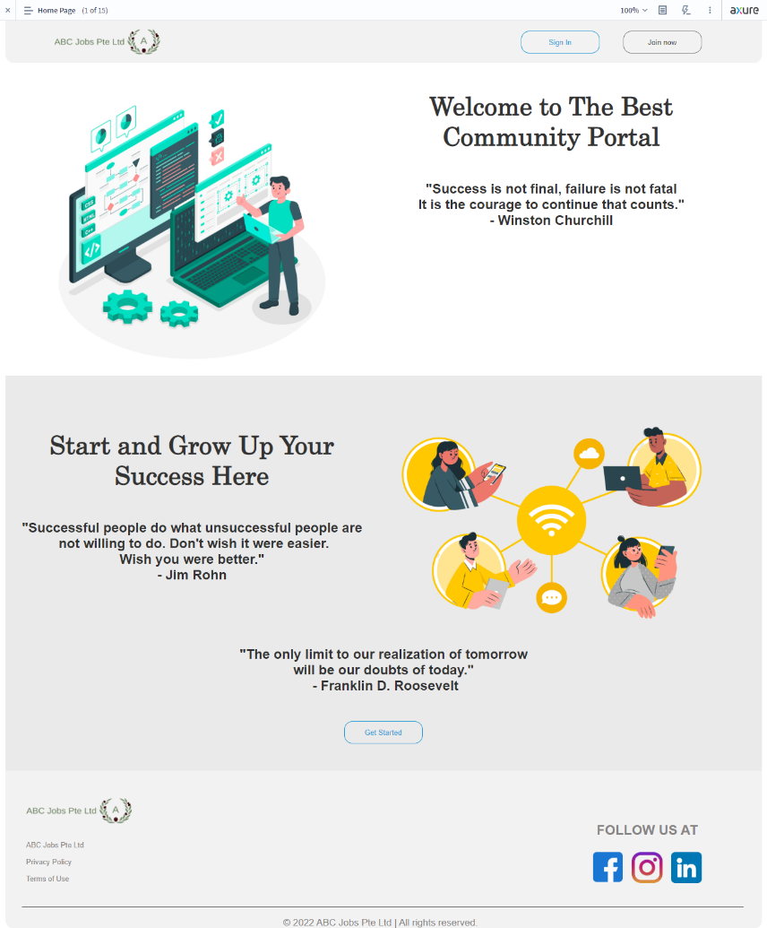
11. Prototype Screen
Beta Version | Final Version | Changes
 |  | Must Add Footer and button to get started

Slide 23
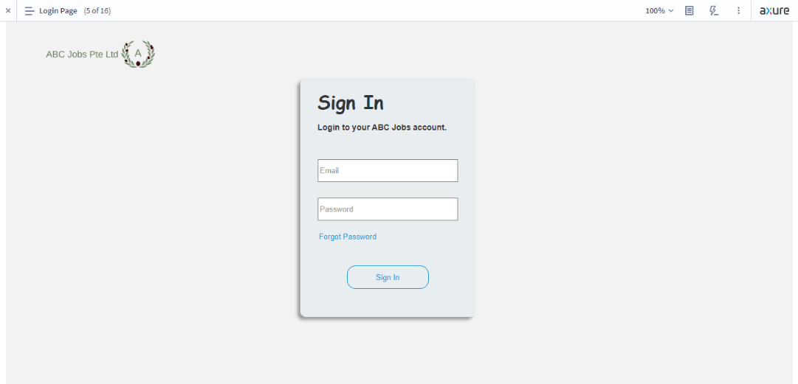
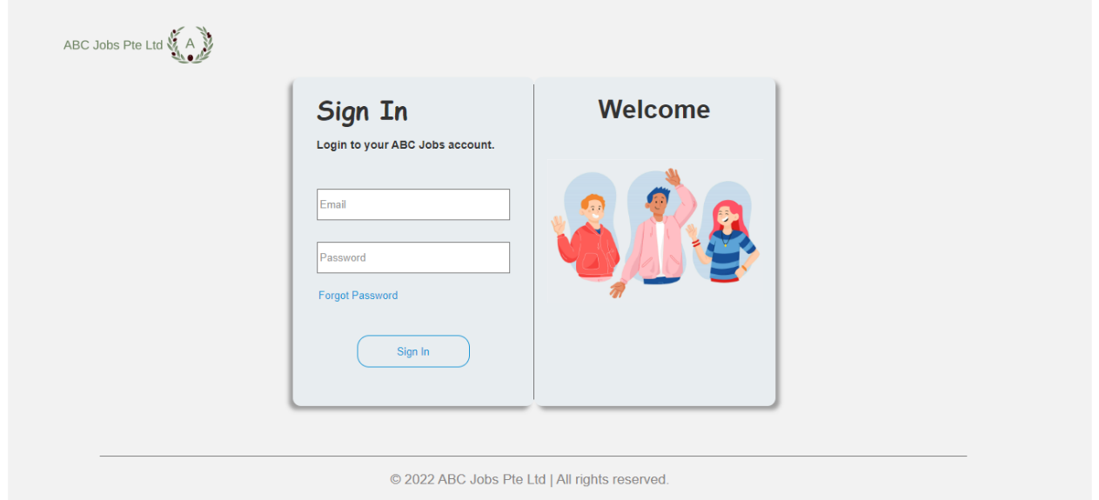
11. Prototype Screen
Beta Version
Final Version
Changes | Adding some layout picture and copy right

Slide 24
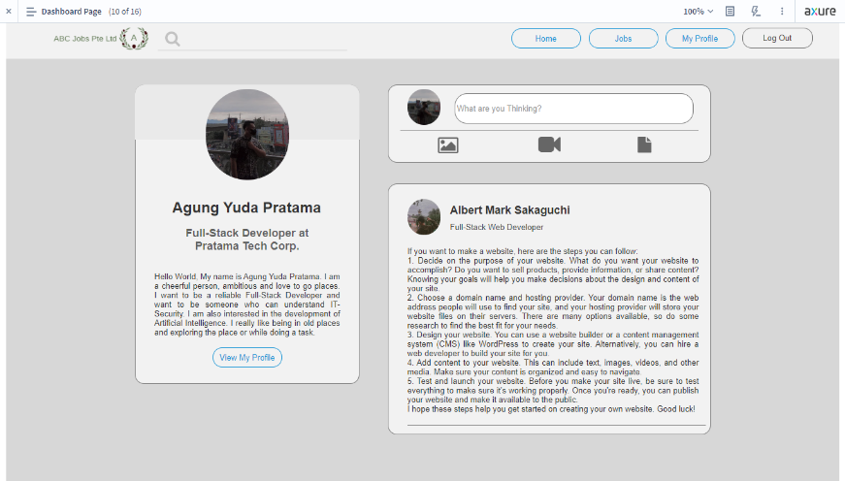
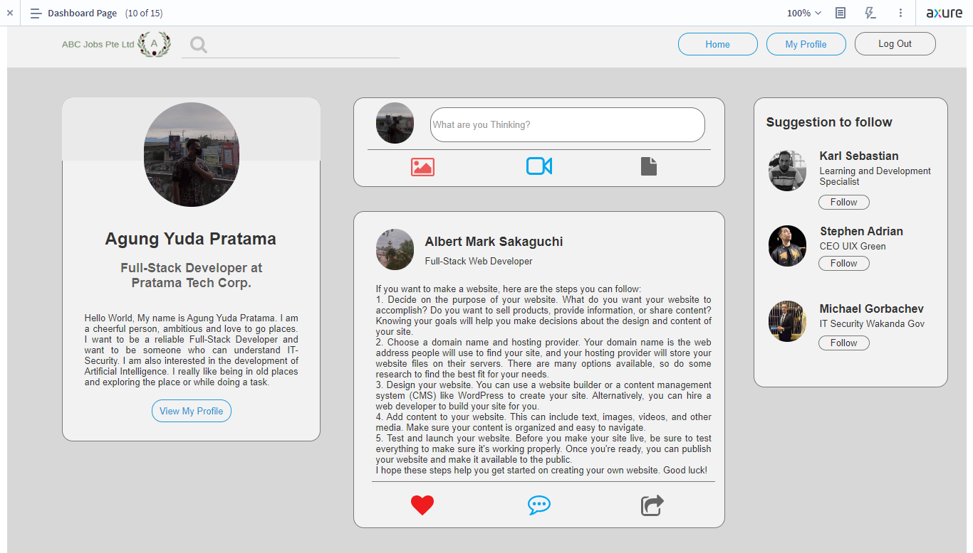
11. Prototype Screen
Beta Version
Final Version
Changes | Adding React, comment, and share button. Adding suggestions to follows

Slide 25
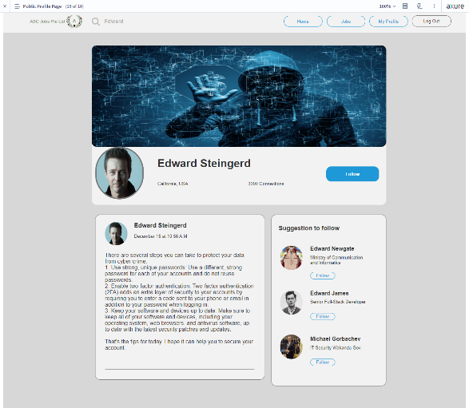
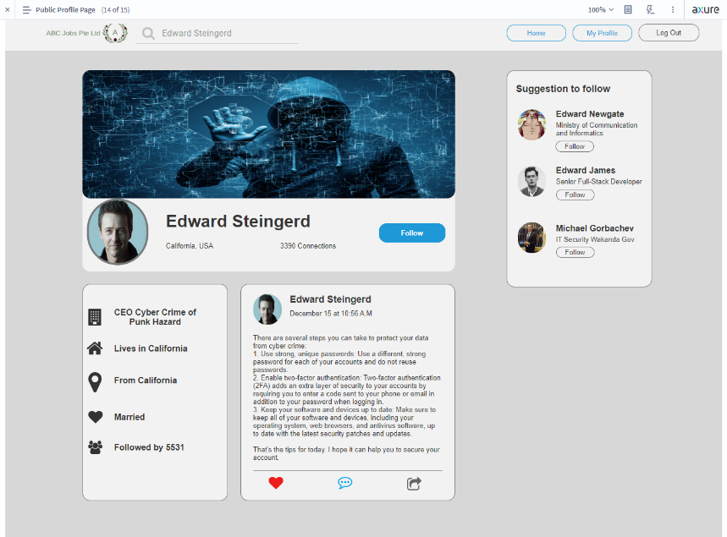
11. Prototype Screen
Beta Version
Final Version
Changes | Adding React, comment, and share buttons. Adding Small Biodata

Slide 26
12. Prototype Feedback
No. | Before | After
1. | No picture, button, footer and less layout in the Homepage | Have more picture, layout and some button also footer
2. | Less some layout picture and copy right in Sign Page | Adding some layout picture and copy right in Sign Page
3. | Not have React, comment, and share button. | Adding React, comment, and share button.
4. | Not Have suggestions to follows | Adding suggestions to follows
5. | No Company search result | Adding Company search result
6. | Not have biodata | Adding Small Biodata
7. | Some button is not linking on the website | Make a button view my profile, edit profile, log out, and search have a function

Slide 27
13. Usability Test
First Usability Test
Registration new account
Second Usability Test
Login with new account.
No. | User | TOT | TSR | CSAT
1 | Anjar Wibawa | 60 seconds | Success | Satisfied
2 | Abdul Rahman | 78 seconds | Success | Satisfied
3 | Syukur | 46 seconds | Success | Very Satisfied
Result |  | 61 seconds | 100% | 100%
No. | User | TOT | TSR | CSAT
1 | Anjar Wibawa | 20 seconds | Success | Very Satisfied
2 | Abdul Rahman | 27 seconds | Success | Satisfied
3 | Syukur | 15 seconds | Success | Very Satisfied
Result |  | 21 seconds | 100% | 100%

Slide 28
13. Usability Test
Third Usability Test
Forgot password account.
No. | User | TOT | TSR | CSAT
1 | Anjar Wibawa | 28 seconds | Success | Satisfied
2 | Abdul Rahman | 30 seconds | Success | Very Satisfied
3 | Syukur | 21 seconds | Success | Very Satisfied
Result |  | 26 seconds | 100% | 100%

Slide 29
14. Project Milestones & Tasks
Project Task ID | Project Task Description | Project Milestone ID
1 | Community Portal Home Page | 1
2 | Registration Page | 1
3 | Registration Confirmation Page | 1
4 | Update Profile Page | 1
5 | Search Users Page | 1
6 | List Search Results | 1
7 | Public Profile Page | 1
8 | Registration Confirmation Email | 1
9 | Login Page | 1
10 | Forget Password Page | 1
11 | Design the Forget Password Confirmation Page | 1

Slide 30
15. Milestone Feedback & Action taken
Project Milestone ID | Milestone Feedback received from Tutor / Learning Facilitator | Action Taken (Yes / No)
1
2
3

Slide 31


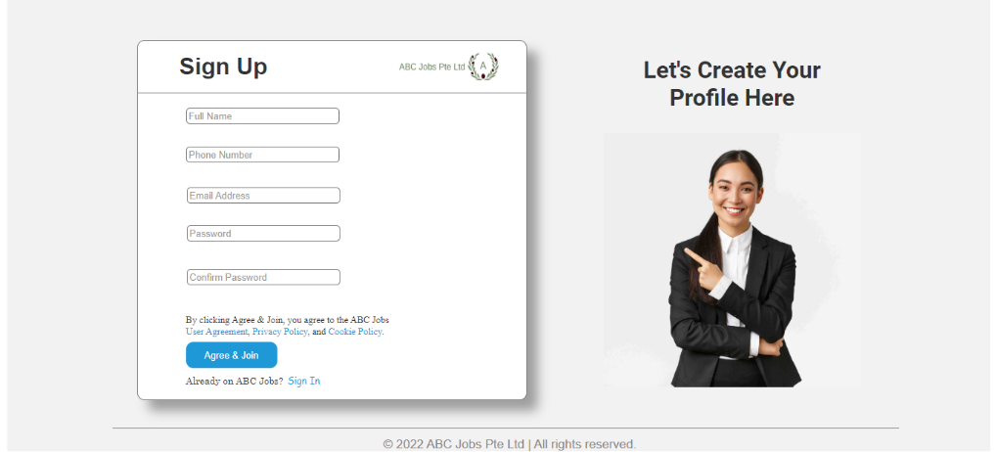
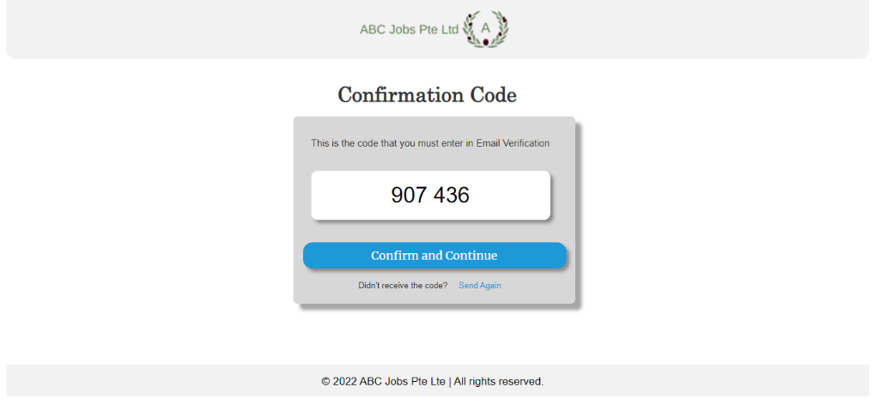
16. Project Results
Screen Capture

Slide 32
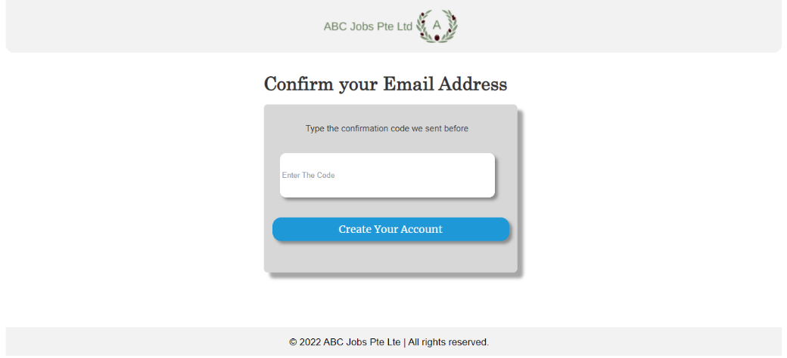
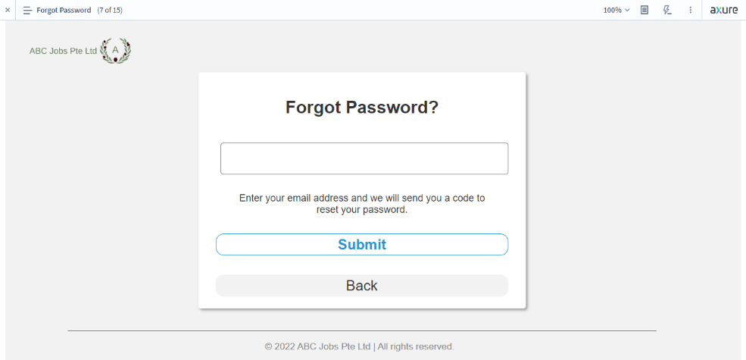

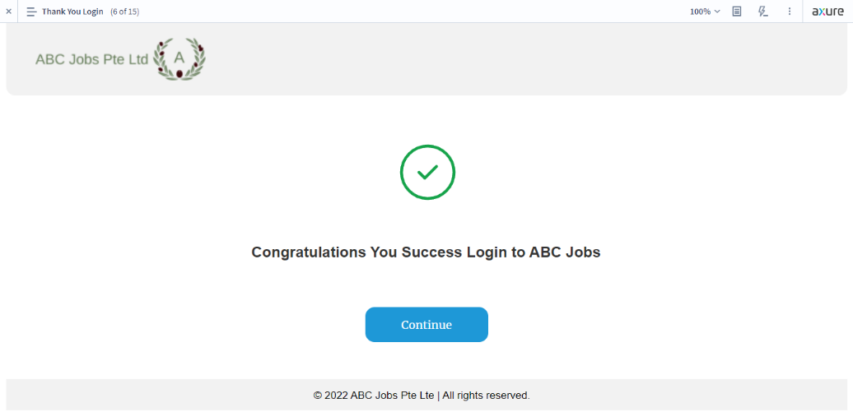
16. Project Results

Slide 33
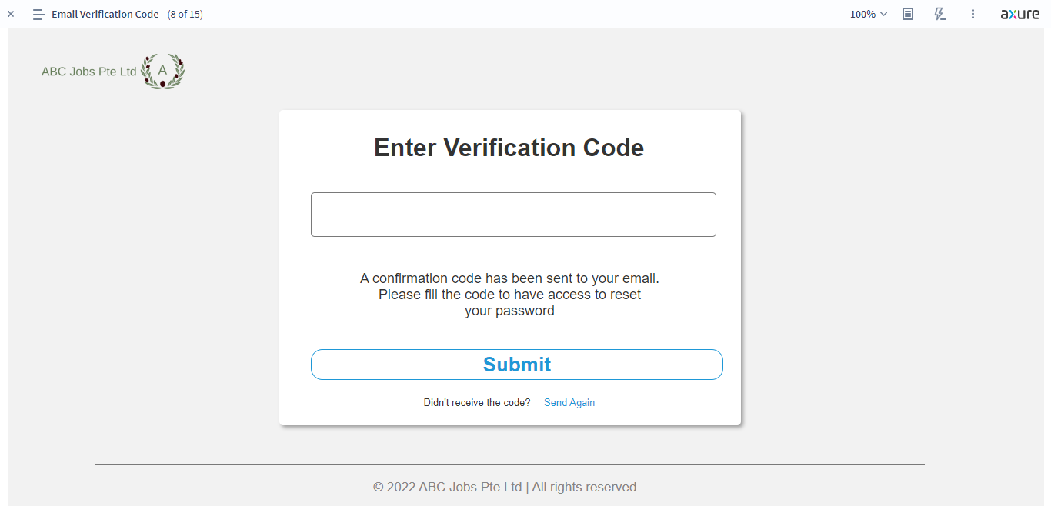
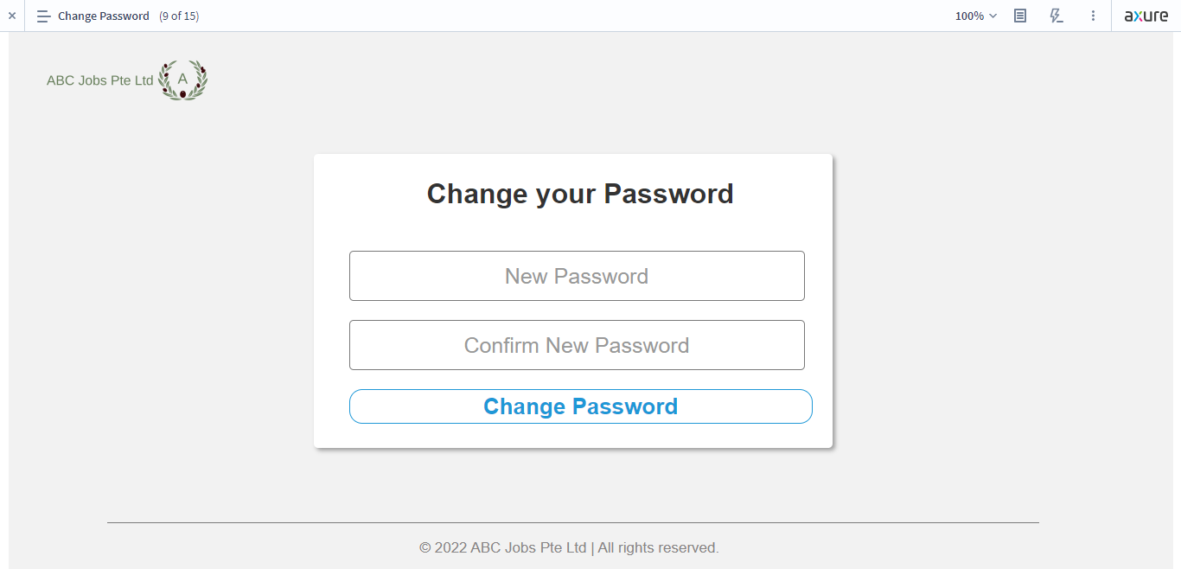
16. Project Results

Slide 34
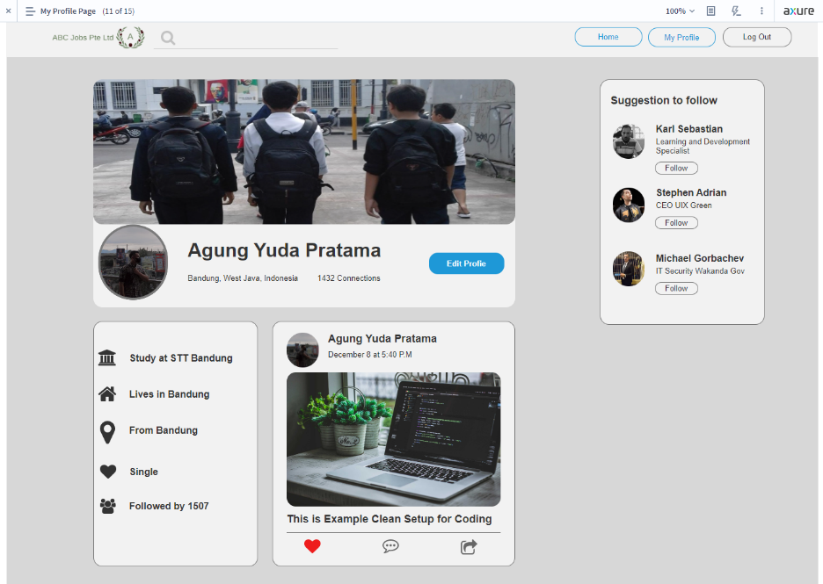
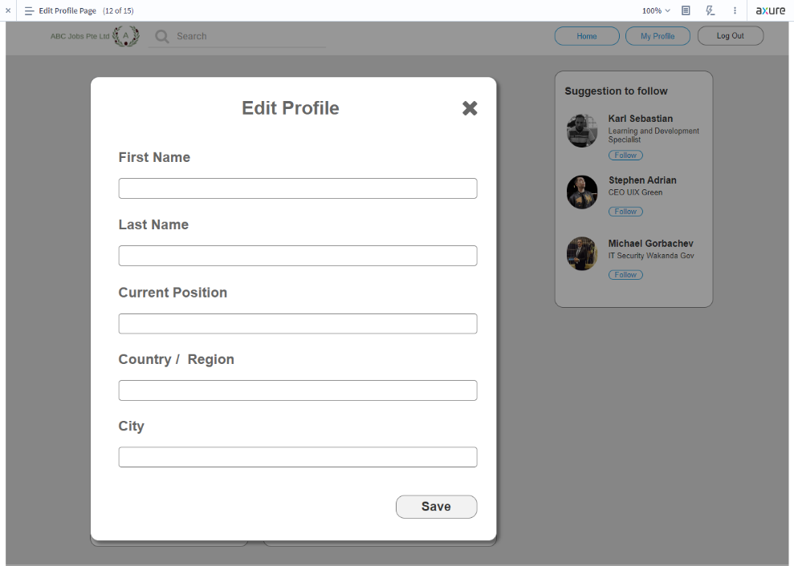
16. Project Results

Slide 35

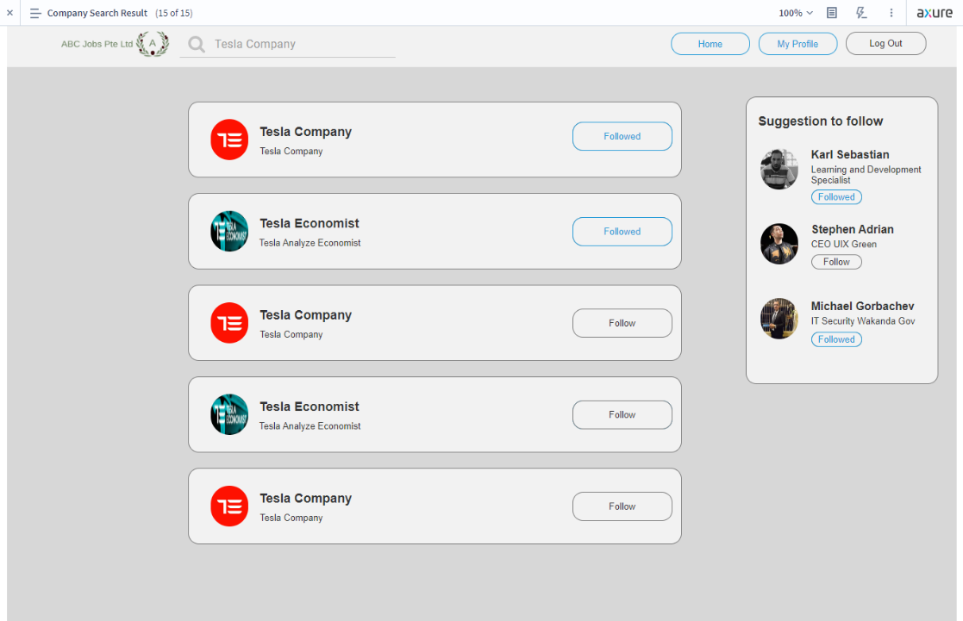
16. Project Results

Slide 36

17. Proposed Improvements
List of Improvements
Need Improvement in the color management
Need More Layout in the prototype
Need More Features like send messages, jobs
Need More Features for creating user

